Slide 1
CMPE 202 Code For Fun
By Amit Bharadia, Dharma Dheeraj Chintala

Slide 2
USECASE Diagram

Slide 3
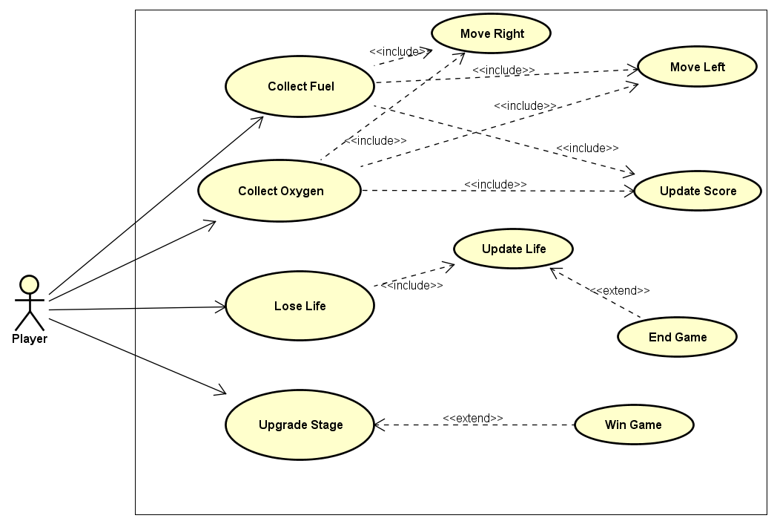

Slide 4
Class Diagrams

Slide 5
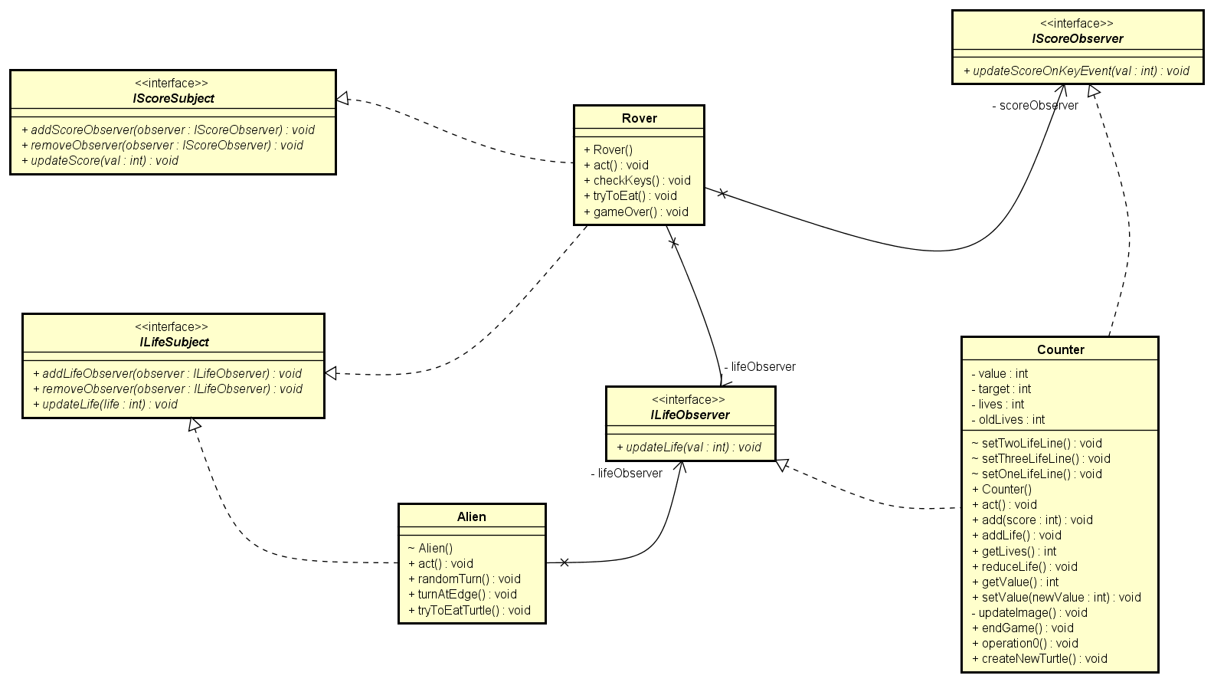
Observer Pattern

Slide 6
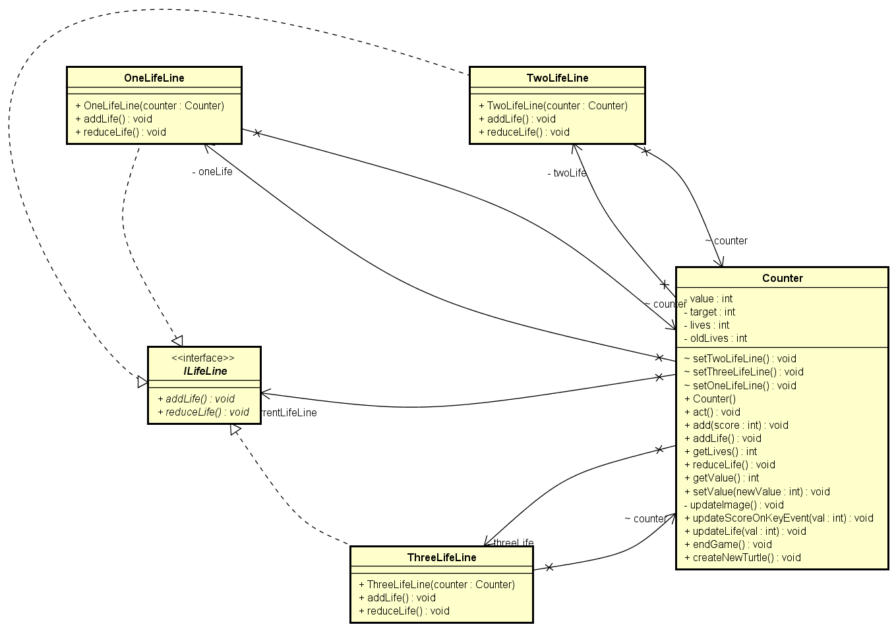
State Pattern

Slide 7
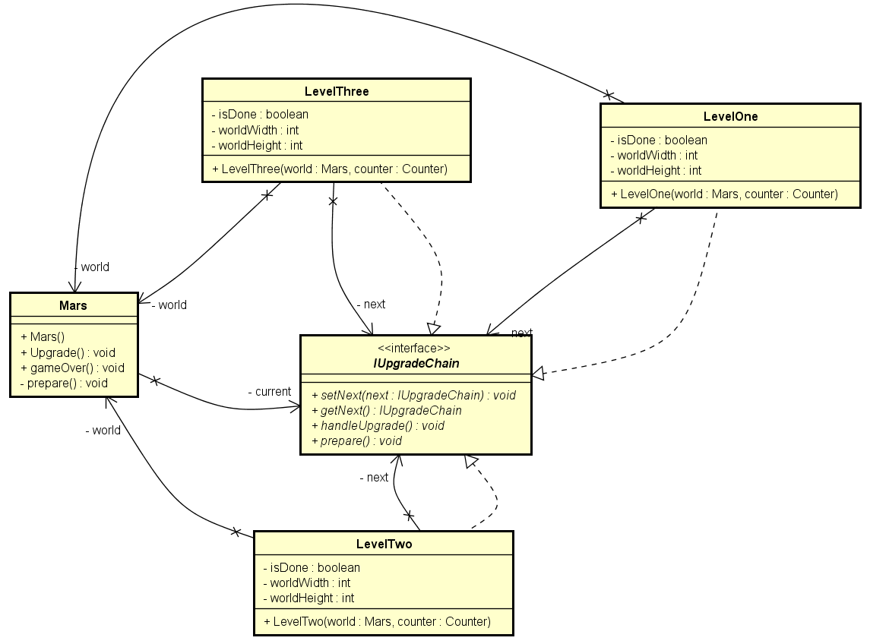
Chain of Responsibility Pattern

Slide 8
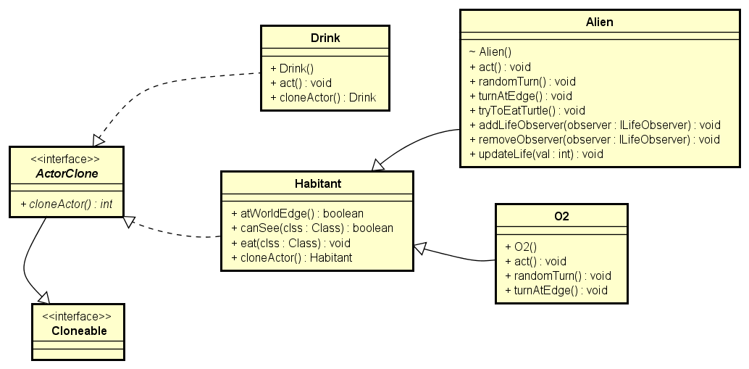
Prototype Pattern

Slide 9
Activity Diagrams

Slide 10
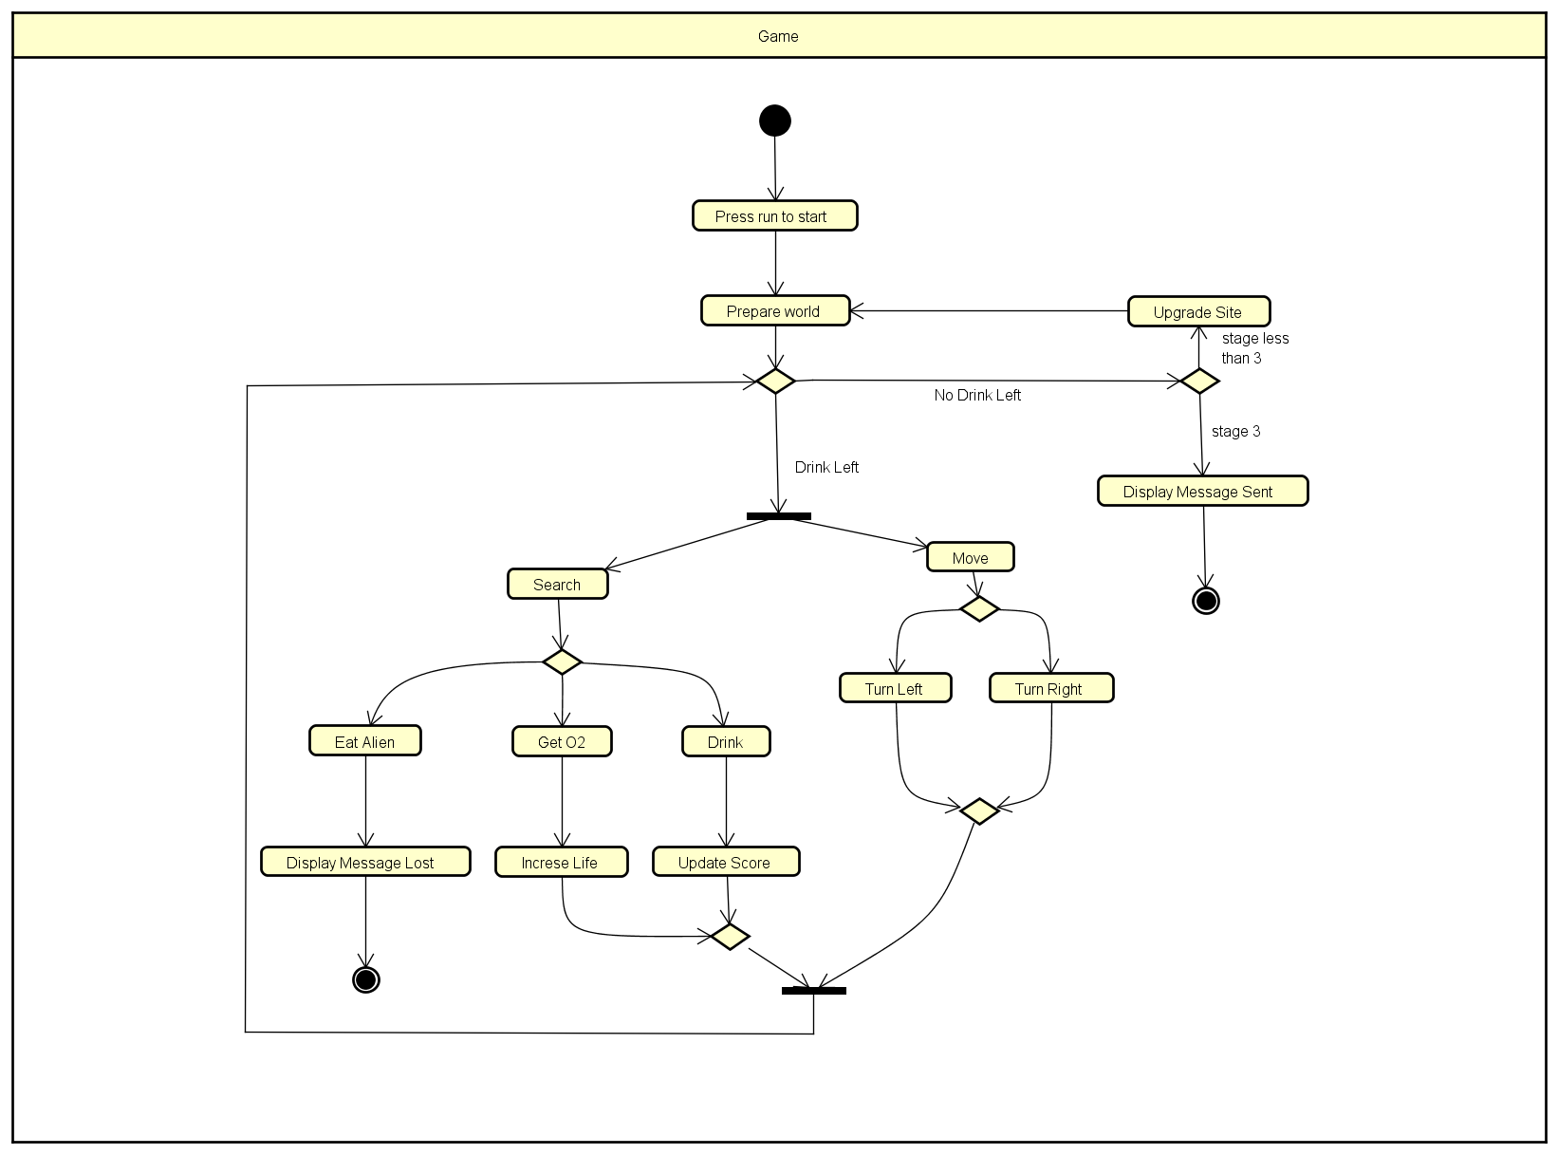

Slide 11
SEQUENCE Diagrams

Slide 12
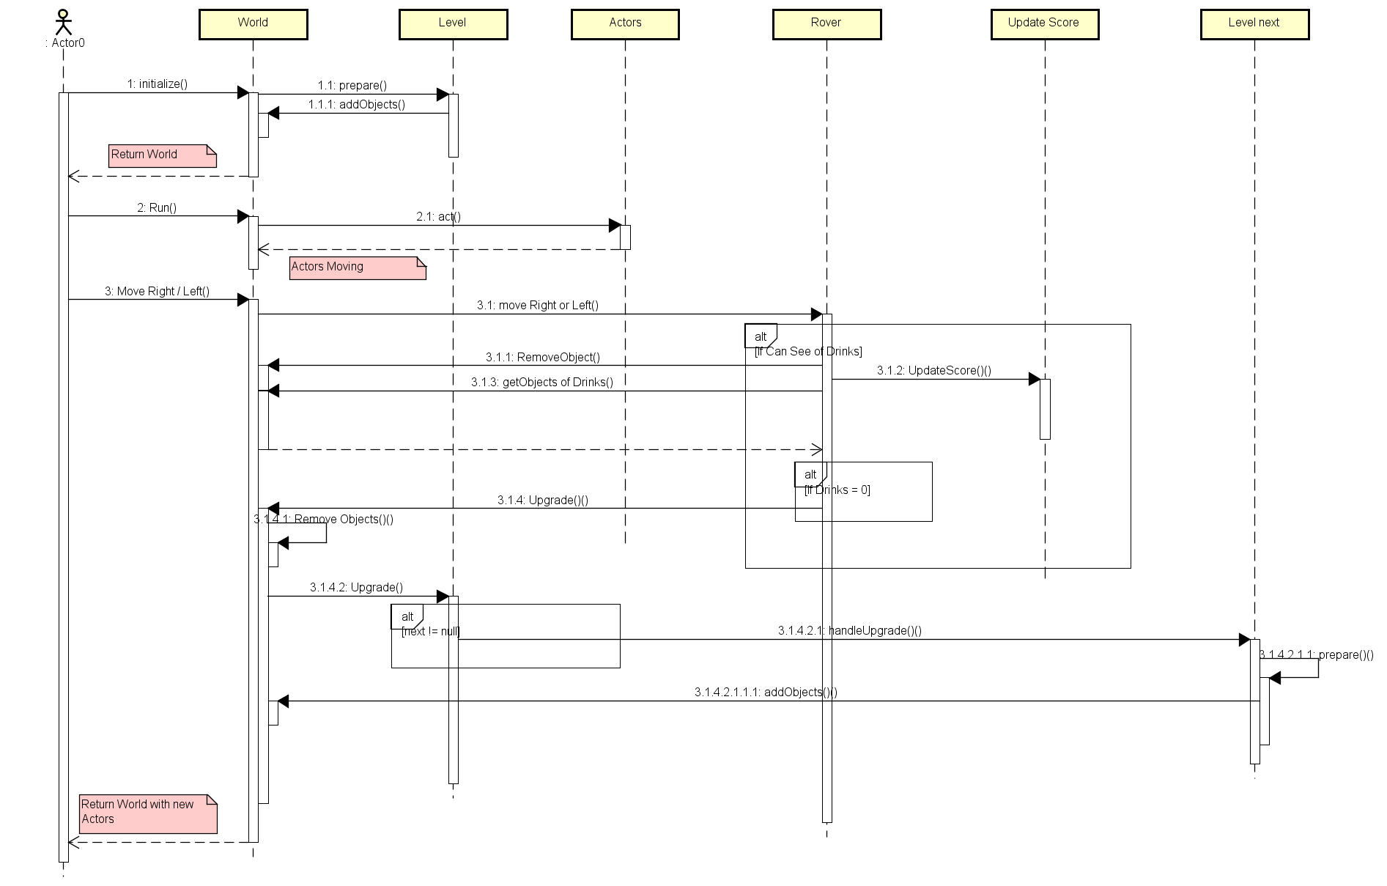
Level Upgrade

Slide 13
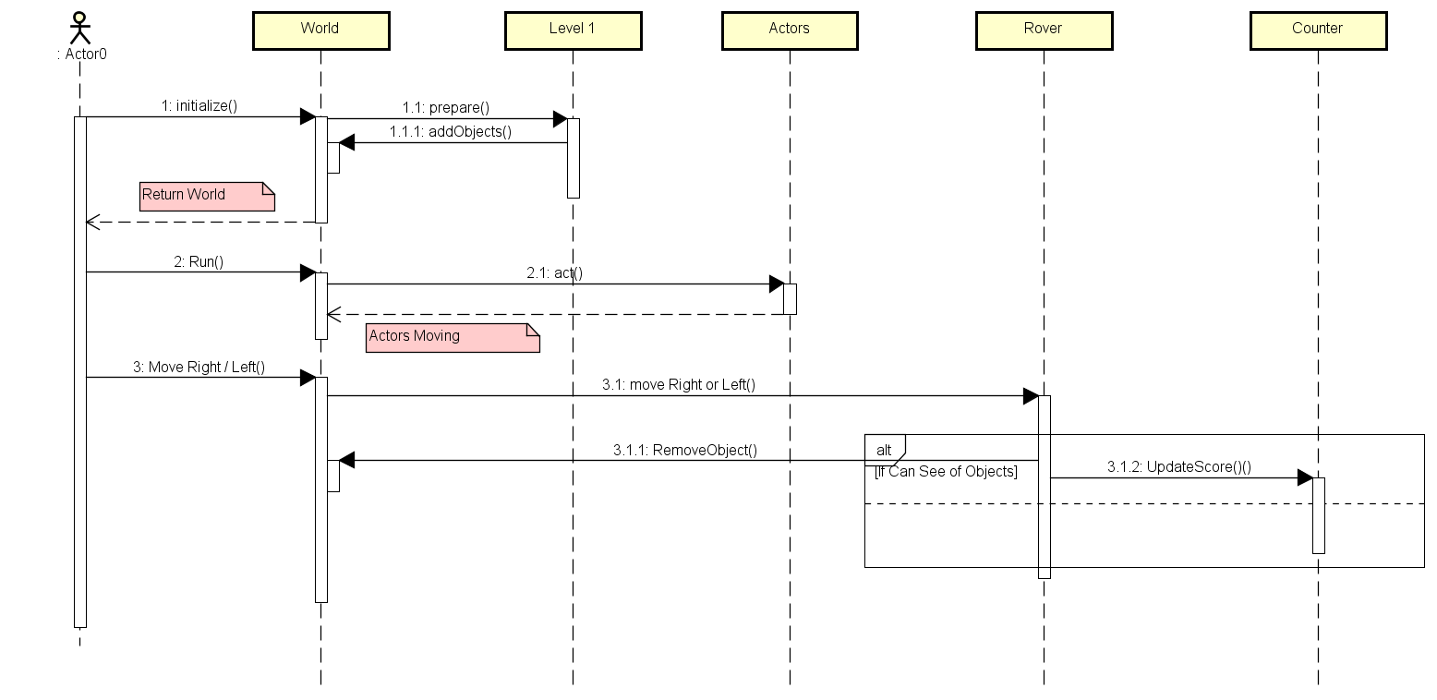
Upgrade Score

Slide 14
Burn down Chart

Slide 15
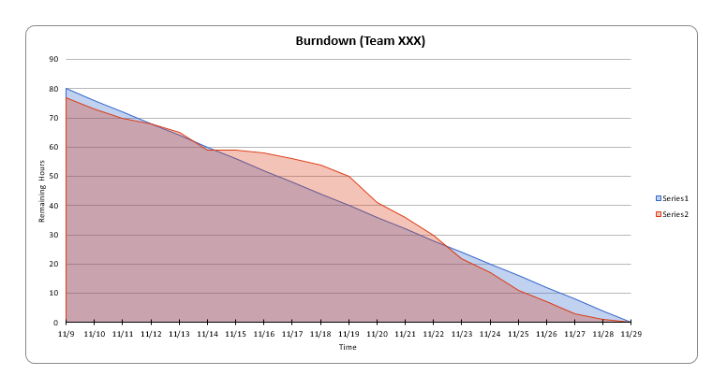

Slide 16
Scrum BOARD

Slide 17
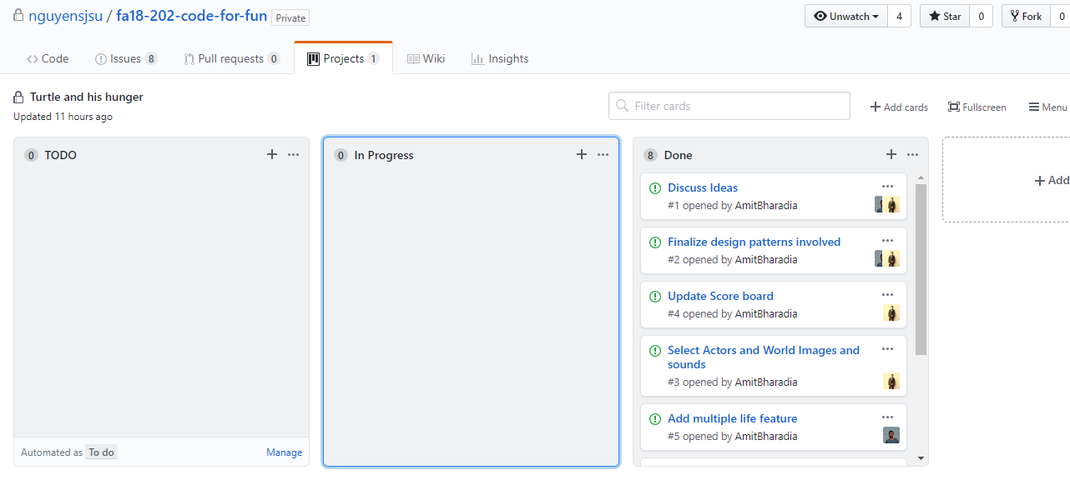

Slide 18
Links to our GitHub Repo
https://github.com/nguyensjsu/fa18-202-code-for-fun
Link to our Team’s Project Board(on GitHub)
https://github.com/nguyensjsu/fa18-202-code-for-fun/projects/1
Link to our Team’s Project Journal(on GitHub)
https://github.com/nguyensjsu/fa18-202-code-forfun/blob/master/Project%20Documents/Project%20Journal.md
Link to our Team’s Sprint Task Sheet
https://docs.google.com/spreadsheets/d/16SG5Yy2xIzYUI_3wfaMvu6BrerhzimhXEbUwTBTJ7l0/edit#gid=442463616
Link to our Team’s Ad Video on YouTube:
https://youtu.be/lZM1UQDtqTE

